Slide 1


Welcome
to our
classroom!

Slide 2
3rd Grade Curriculum
Night Presentation
Everything you wanted to know about 3rd grade and more!

Slide 3
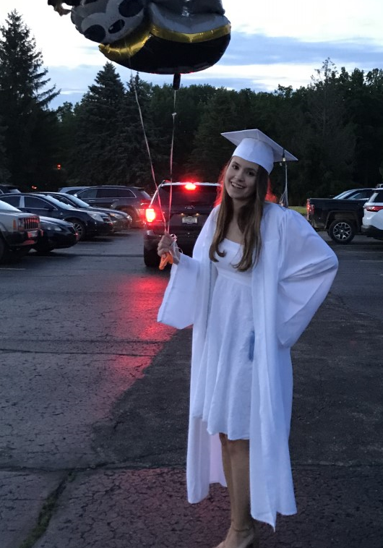
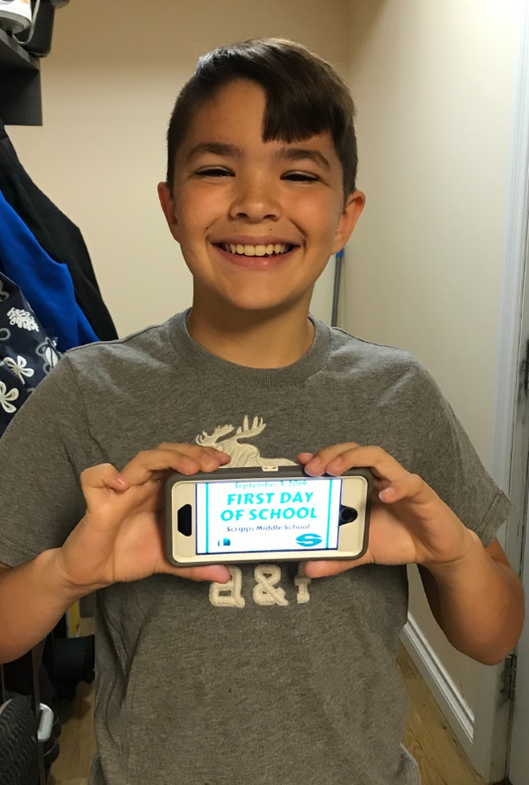
Mrs. Heidi Boyer
Introducing…
*married with 2 children
*U of M graduate… GO BLUE!
*Masters in the Art of Teaching
*taught 4th grade for eight years
*then switched grade levels, and this will be my 15th year teaching 3rd grade
*LOVE, LOVE, LOVE working with students
←Gage
Alex →
CMU Freshman 7th

Slide 4
Agenda
Curriculum by subject
https://www.lakeorionschools.org/uploaded/Lake_Orion/Documents/Curriculum/AT_A_GLANCE_-_3_ATWATER.DOCX.pdf
Standards Based Grading and Report Cards
Important Classroom Information and Policies
Special Rotation Schedule
Sign Up Genius will be emailed out on Friday, September 13th to sign up for November conferences

Slide 5

3rd Grade Science Curriculum
Life Science (Plants, Animals, Life Cycles, Traits,
Adaptations)
Physical Science (Force & Motion, Weather/Climate)
Engineering and Design

Slide 6

3rd Grade Social Studies Curriculum
History (Michigan’s history from exploration to statehood)
Geography (cardinal directions, regions, Michigan’s natural resources)
Civics & Government
Economics
Public Issues
Meet Michigan-McConnell
Lansing Field Trip: MAY 15

Slide 7

3rd Grade English Language Arts Curriculum
Literacy- Reading with Fluency and Comprehension
Read Aloud with Discussion
Reading Workshop (Units of Study for Teaching Reading –Calkins)
Writing Workshop (Units of Study for Teaching Writing–Calkins)
Word Study (Words Their Way- Johnston et al., 2009)
Cursive Handwriting (Zaner-Bloser Handwriting – Hara) →

Slide 8
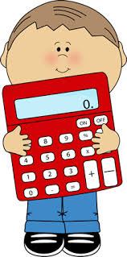
3rd Grade Mathematics Curriculum
Operations & Algebraic Thinking
Number and Operations in Base Ten
Number and Operations- Fractions
Measurement and Data
Geometry
Rocket Math- building basic facts automaticity →
Math Expressions (Houghton Mifflin Harcourt- Fuson)

Slide 9
Read by Grade Three Law
All third grade students will be required to take a standardized state assessment (M-STEP) in the spring to determine promotion to fourth grade. If your child is reading one year below grade level at the end of third grade, you will be informed in June/July from the office of Center for Educational Performance and Information (CEPI) in writing that your child will not be promoted to fourth grade unless he/she qualifies for a good clause exemption.
For more information, please visit: https://www.lakeorionschools.org/teaching-and-learning/third-grade-reading-legislation .

Slide 10
Standards Based Grading in a Nutshell
Instead of doing a test at the end of each topic and giving a student a letter grade for the whole test, the topic is dissected into individual concepts and skills ("standards”) and are assessed for their ongoing understanding in each standard using a simple scale such as:
4- Met standard
3 - Consistent progress toward standard
2 - Inconsistent progress toward standard
1 – Area of concern
This type of grading makes the process visible to students, and it gives them opportunities to be re-evaluated on standards. The goal is to have meaningful formative assessment which supports an ongoing learning conversation with students while providing visible and timely feedback to both the students and teacher.

Slide 11
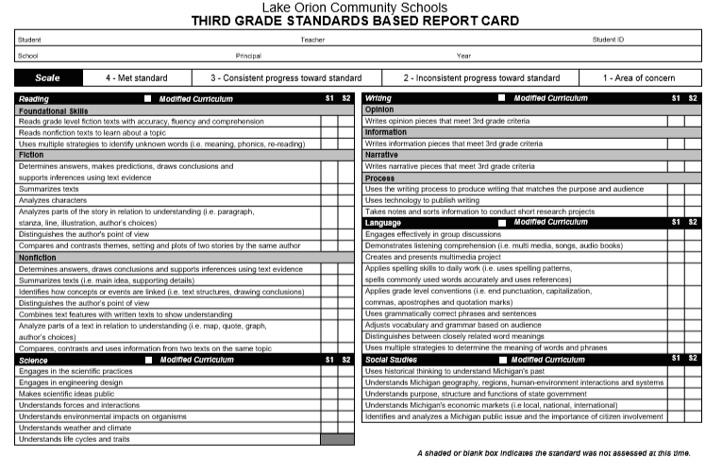
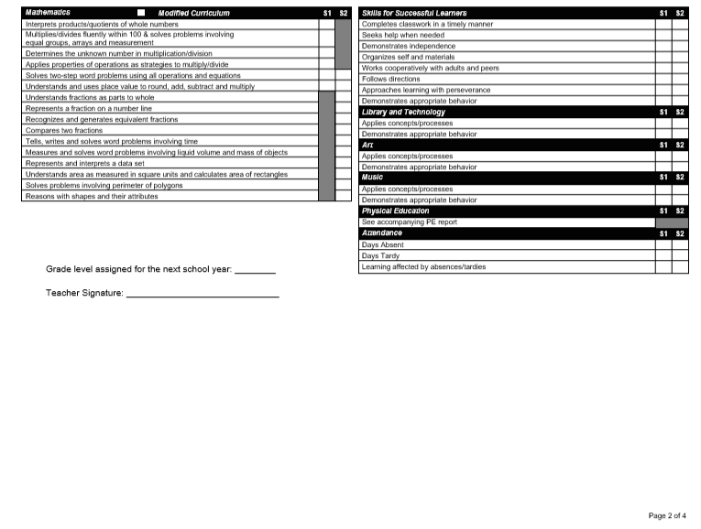
Report Cards (January and June)
Front of card Back of Card

Slide 12

Specific Classroom Information to Follow…
Communication
Snacks and Lunch/Recess
Quick review of Yellow Stapled Sheet
Classroom Rules
Positive Reinforcement

Slide 13
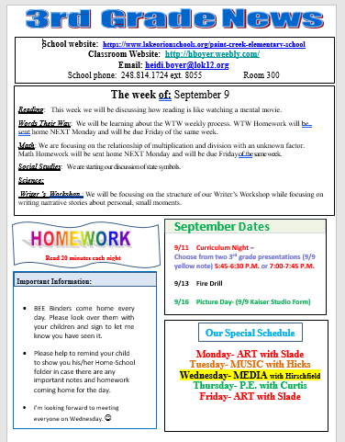
Classroom Newsletters
A classroom newsletter will be sent home every Monday and will be accessible online at hboyer.weebly.com. It will contain important information regarding skills that we will be learning in the classroom as well as notes about homework, special events and other vital information.
FYI: http://hboyer.weebly.com will allow you online access to all important classroom news and homework

Slide 14
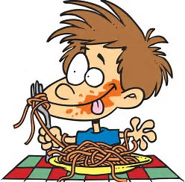
Snacks and Lunch/Recess
9:50 Morning Snack
11:55 – 12:17 Lunch
12:18 – 12:40 Recess
Please send a Peanut-Free and Tree Nut-Free snack with your child every day.
Remind your child to pay for his/her lunch when he/she signs up in the morning.
Please send in a water bottle to help your child stay hydrated during the day.

Slide 15
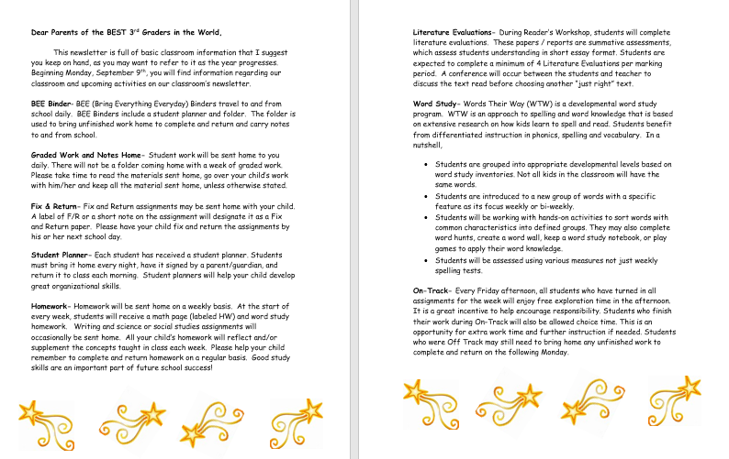
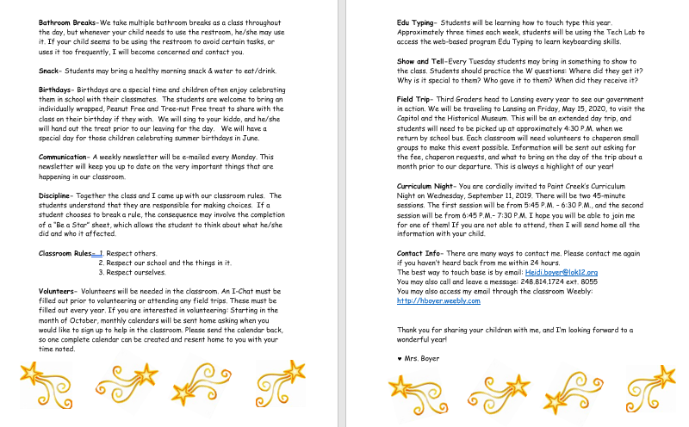
Refer to the Stapled Sheet (sent home 9/7)

Slide 16

Classroom Rules
Respect Others
Respect Ourselves
Respect Other’s Property

Slide 17

Positive Reinforcement
On the spot reinforcement – catching single or groups of students doing great things and giving:
Shout outs and Table Stars
Table Tallies
Stickers
Notes and phone calls home

Slide 18

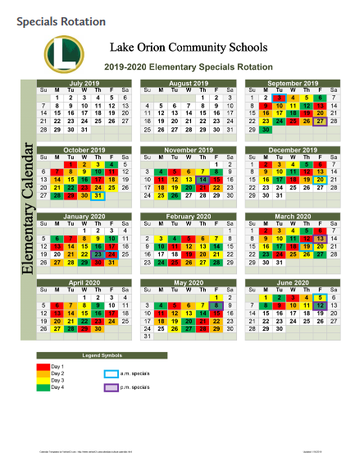
Directions for using this calendar:
We have 4 specials (Art, Music, Media and PE) which rotate throughout the year. The colors red, orange, yellow and green on the calendar correspond with each Special (see the Color Coding key listed on the calendar), and rotate in the same order over and over again: Art, Music, Media, PE, Art, Music, Media, PE, etc.
This means that we WILL NOT ALWAYS have Art on Tuesday, Music on Wednesday...
Our specials will be every day from 9:00-9:45 A.M.
Special Schedule

Slide 19
November Conference Sign Up
Conference times will be twenty minute increments:
11/12 (Tues) from 4:00-8:00 PM
11/14 (Thurs) from 12:30-7:00 PM
A SignUp Genius will be sent out Friday, September 13th by email.
Please let me know if you are not receiving SchoolMessenger emails from me.

Slide 20

Contacting Mrs. Boyer
Email Heidi.boyer@lok12.org
Room phone number 1.248.814.1724 ext. 8055
Letters in the planner
Please allow 24 hours for a response to a question.

Slide 21
LAKE ORION BOND UPDATES
Lake Orion Community Schools Bond Update Link
To access information regarding Bond Updates:
Click on the link provided: https://www.lakeorionschools.org/district/bond-implementation
Use the interactive map to show the initial capital improvement projects that will be completed in the first series (2019-21) thanks to the successful passage of the 2018 Lake Orion Community Schools Bond Election. (click on the blue teardrop shapes to see what is happening around the district during series 1.)
Paint Creek is slotted for improvements during the series 2 (secure) years 2020-2021 and series 3 (renovation) years 2024-2025.

Slide 22

Thank you for attending Curriculum Night!
We are going to have a great year!
We are going to have a great year!
We are going to have a great year!
We are going to have a great year!
We are going to have a great year!
We are going to have a great year!
We are going to have a great year!

